Slide 1


Contact Management System
St. Francis Institute of Technology
Department of Computer Engineering
Group Members
Name | Roll No.
Daniel Lobo | 07
Jenny Dcruz | 16

Slide 2
Content
Introduction
Experimental Setup
Components
Working
Experimental setup
Conclusion

Slide 3
Introduction
The “Contact Management System” is an application that has been developed to override the problems prevailing in the obsolete manual system. This application’s features eliminate and reduce a few of the hardships faced by the existing system. No formal knowledge is needed for the user to use this system. Thus, making it easy-to-use. It’s a reliable and error free management system that is at the user’s disposal. With this Contact Management System, one has the freedom to focus on other activities rather than having to keep a record of all their contacts.

Slide 4
Introduction
Besides automating the extant, manual telephone directory, it allows the user to store contacts for a long period of time with easy accessing and manipulation of the same. As the application is developed using Flutter, it’s compatible with both, android and ios devices of all dimensions. The main objective behind this project was to create a one-stop place for a user to store, view, edit and delete a person’s contact number, email address, and their residential address.

Slide 5
Experimental Setup
Software: Android Studio
Mobile UI Framework: Flutter
Programming Language: Dart
Database: SQFlite
Maps: Maps SDK from Google

Slide 6
Components
The contact management system provides a simple, yet aesthetically pleasing home page to the user that displays the names of all the existing contacts in the system.
Further, it consists of the following features:
Adding a contact
Editing a contact
Deleting a contact
Contact card’s GUI
Maps
About us

Slide 7
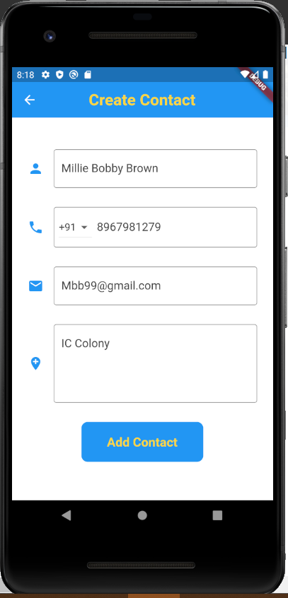
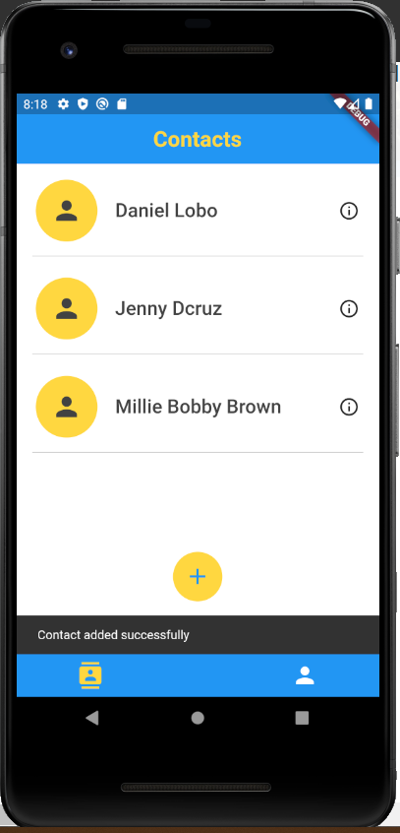
Working: Adding a contact
This redirects the user to the ‘Create Contact’ page wherein the name, phone number, email id and residential address can be entered to store in the device.

Slide 8
Working: Editing a contact
Our application provides an edit contact feature. To use this, one needs to simply swipe a name field on the home page, from right to left. On swiping, the user has been presented with two options: Edit or delete. When the edit option is selected, the user can edit any and every field of the contact stored. Once the edited information has been saved, it efficiently gets updated in the database and an alert arises informing the user that the contact has been updated successfully.

Slide 9
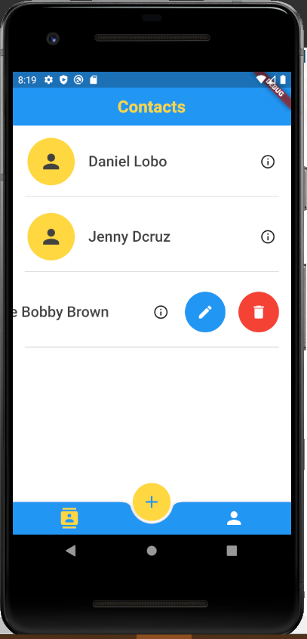
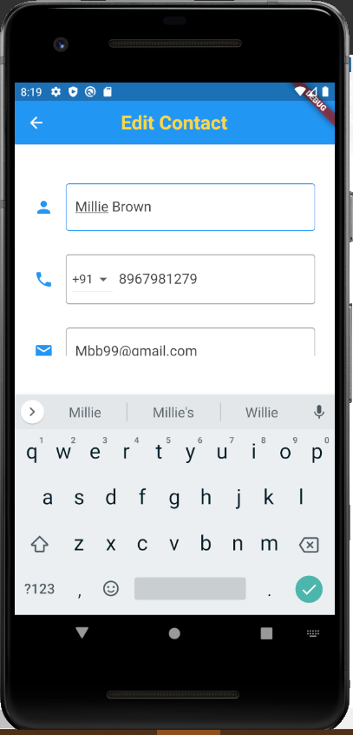
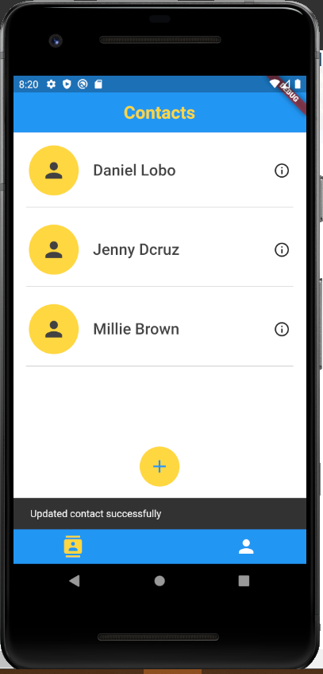
Working: Editing a contact

Slide 10
Working: Deleting a contact
As mentioned before, swiping a contact field in the home page provides the user with two options. If the user chooses to delete a contact, a pop up message appears in order to confirm if the user indeed wants to delete the contact. This extra step of confirmation gives the user a minute to think if they definitely want to remove this contact as once the contact details are deleted they can’t be retrieved.

Slide 11
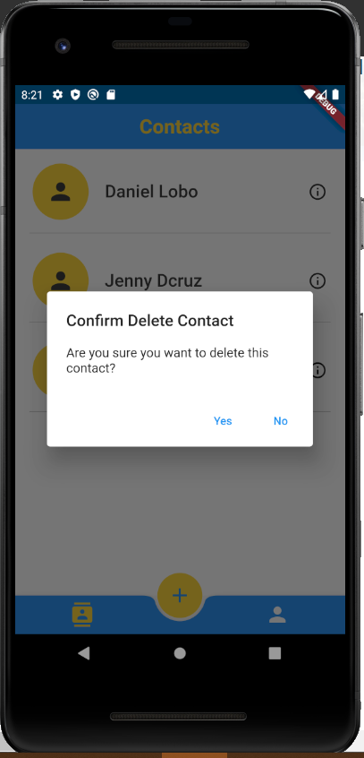
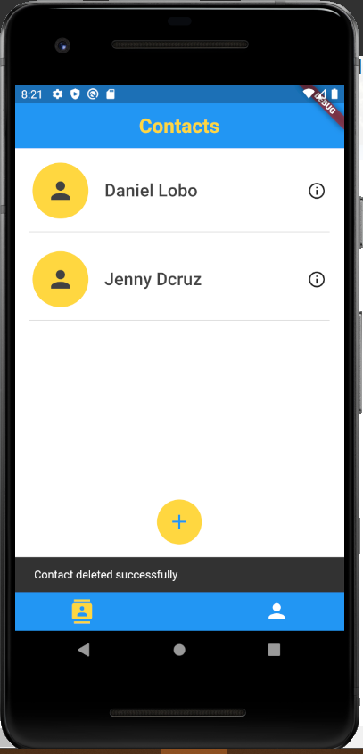
Working: Deleting a contact

Slide 12
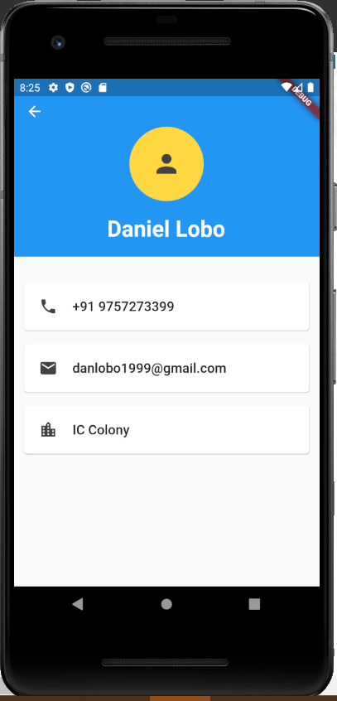
Working: The Contact card’s GUI
The saved contacts in the system can each be viewed individually by clicking on the contact fields in the home page. The contact card of every user displays the phone number, email address and residential address of every contact as added before.

Slide 13
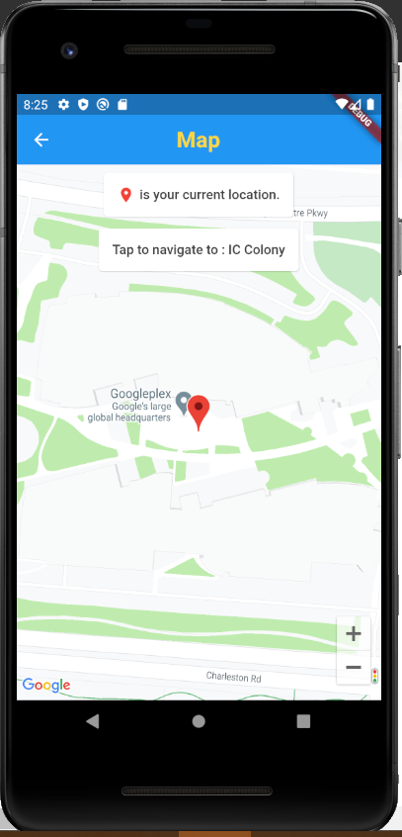
Working: Maps
To display the location of the contact’s saved address, the application uses the Google Maps API key. The ‘Tap to navigate to:’ feature in the map opens up the google maps application with the same address loaded in the search bar.

Slide 14
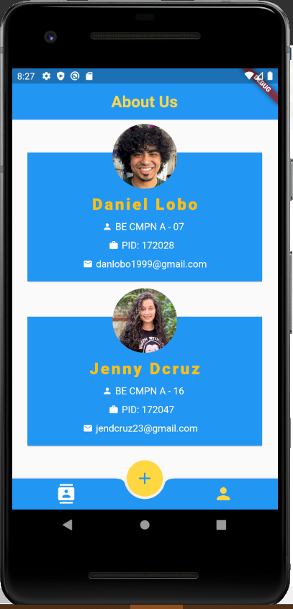
Working: About us Page
Last but not the least, the ‘About us’ page. This page displays the details of the developers of this application.

Slide 15
Conclusion
In conclusion, our project is a humble venture to an efficient way of storing and managing all essential data of a contact.
The application created in this project has proven to be successful economically, technically, and operationally.
It is feasible as it’s an error-free, cost-efficient, user friendly, and flexible application.

Slide 16
Thank you

